Slide 1
Sales Predictions
By Kim Kibo
October 22, 2021

Slide 2

Sales Predictions
The purpose for this project is to predict for food items sold at various stores and to show the types of products and factors that are important in projecting and increasing sales.

Slide 3
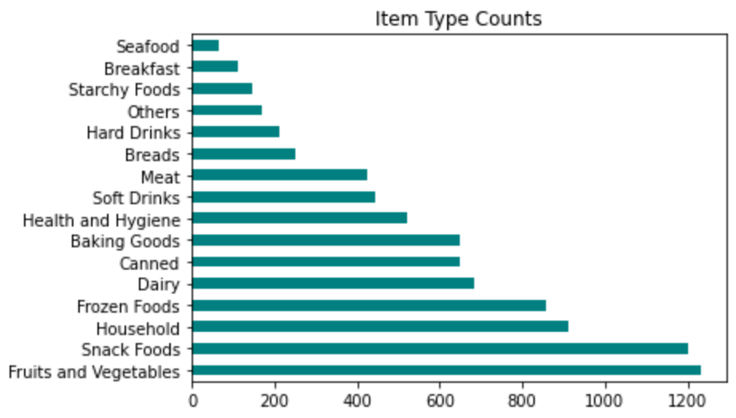
Item Type Counts

Slide 4
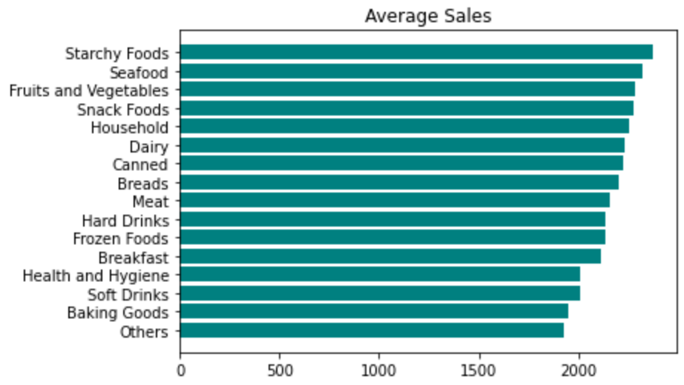
Item Types Average Sales

Slide 5
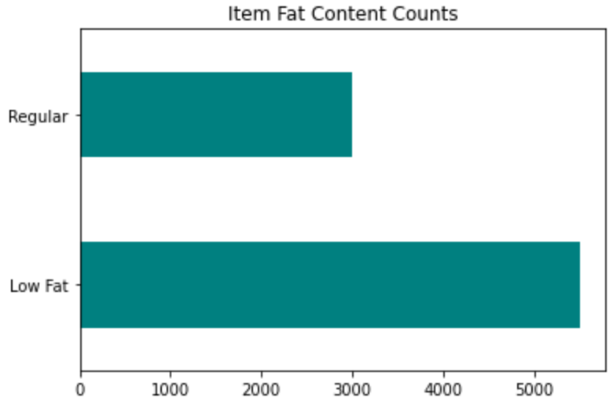
Item Fat Content Counts

Slide 6
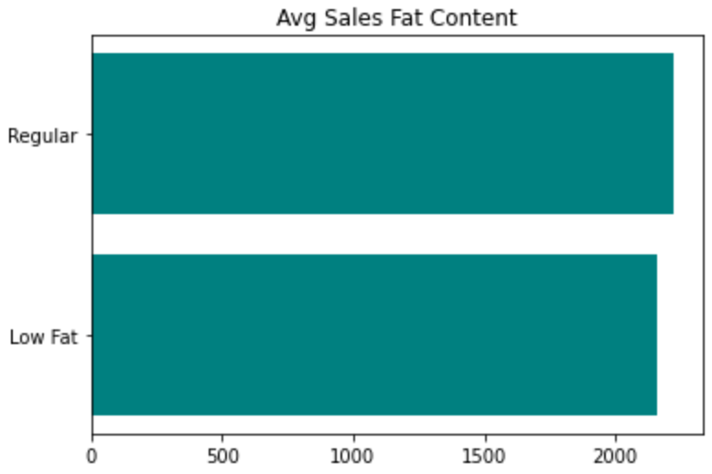
Item Fat Content Average Sales

Slide 7
Important Features to Predict Sales
The top three important features in the data to predict sales are:
Item MRP - maximum retail price
Outlet type that are grocery stores
Item Visibility

Slide 8
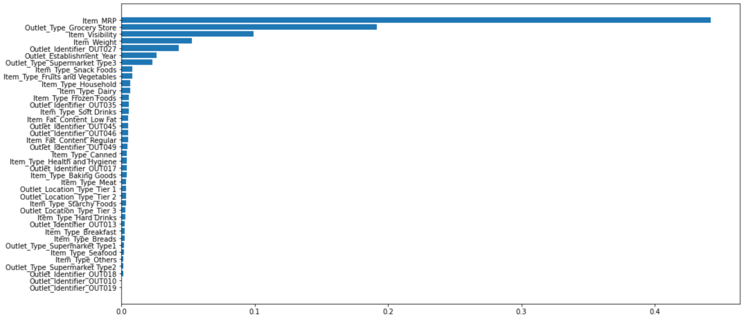
Important Features to Predict Sales

Slide 9
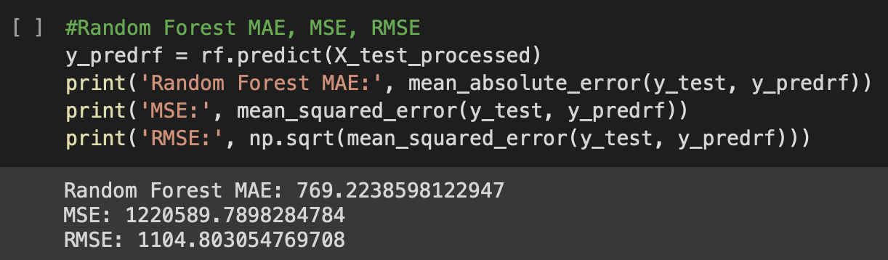
Recommendations for predicting sales
The Random forest model is best for predicting sales and further data analysis compared to other models used. Its scores indicate that it has better fit and response to the data.

